Slide 1



2018
川报观察移动端
Android第四组
张睿 姚壮 石林玲 涂畅

Slide 2
CONTENTS
Start
Process
End

Slide 3
S
T
A
R
T

Slide 4
What has been chosen
项目名称 | 川报观察移动端
项目成员 | 张睿、石林玲、涂畅、姚壮
项目描述 | 阅读新闻； APP常见功能，比如启动引导页； 介入四川日报电子版； 专题、活动等常规的新闻客户端功能； 话题功能等
ADD TO OUR TEAM
ADD TO OUR TEAM
ADD TO OUR TEAM
In this part you should describe your business to the investor. You have to make sure he can make it clear
In this part you should describe your business to the investor. You have to make sure he can make it clear
In this part you should describe your business to the investor. You have to make sure he can make it clear

Slide 5
Early Stage
Metaphase
Later Stage
策划阶段，需求分析，分析设计
It’s most important in all.
编码阶段，实现需求分析中的功能，测试每个实现的功能，UI美化
In this part, you can show your exquisite skills
集成测试阶段，交付项目成果
It does not mean that everything is ok. There are much unbelievable events waiting for you.

Slide 6
At the beginning
Everyone has different roles and was distributed with different work.
Role of member
张睿小组长，石林玲系统分析师，涂畅产品经理兼需求分析师，姚壮CM兼需求分析师
Division of labor
张睿小组长负责项目进度编码，石林玲完成分析设计，涂畅、姚壮完成需求分析，测试等工作

Slide 7
P
R
O
C
E
S
S

Slide 8
Analysis And Code
后期维护
需求分析
功能编码
项目交付
策划阶段
集成测试
分析设计
IT is our best state
按照流程走。每个人分一些任务。在每一个阶段都事情做。

Slide 9
CODE
BUG
write
debug
不停的寻找，不停的尝试，不停的完成
每一次尝试都不停的有bug，心情那个纠结；每一次解决bug，心情有事无比的舒畅

Slide 10
F
E
N
D

Slide 11

Achievements
F
N

Slide 12
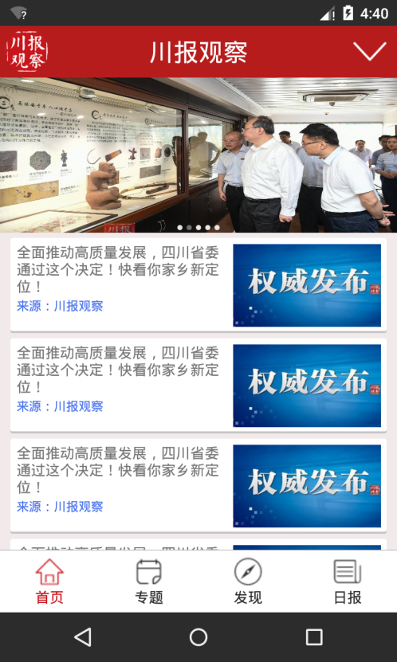
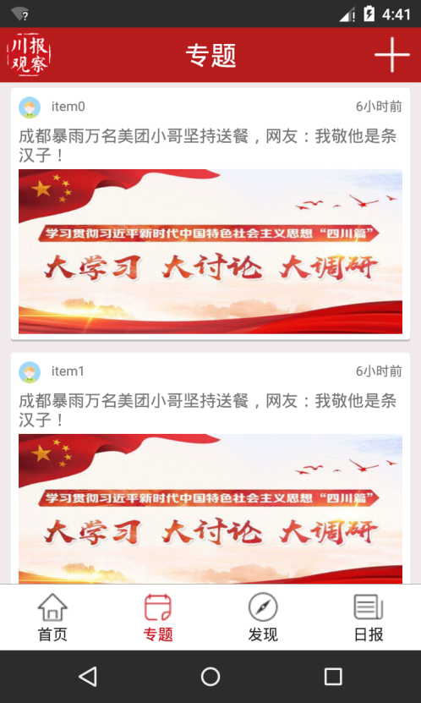
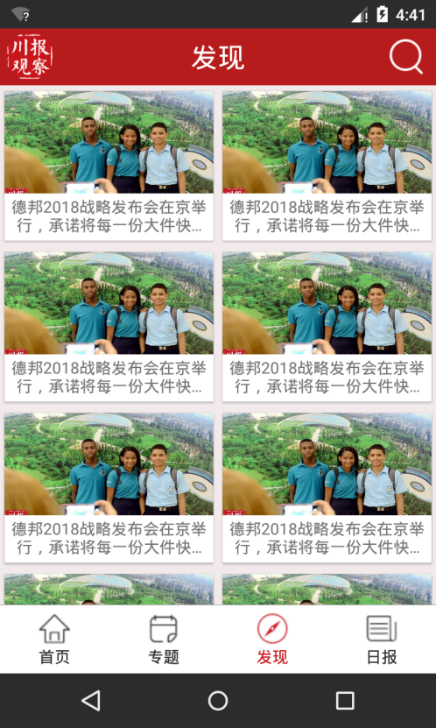
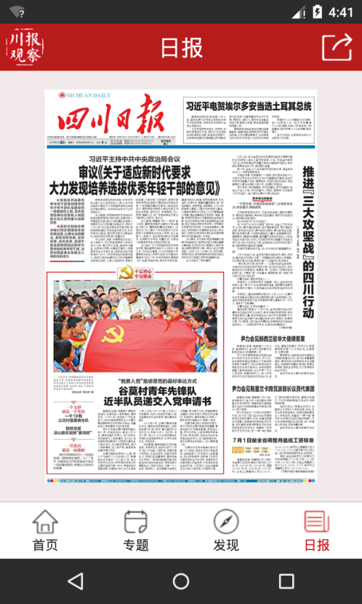
Achievements
F

Slide 13
Summery
Basic Knowledge
Professional Skills
了解一个新的东西，对Java语言的更加熟练
一次次的课程学习，不如一次实践来的实际，实地的开发，很快的增进自己的技能，变得更加娴熟
Team Work
Attitude
增进自己的团队意识，学会team work，树立一个个小目标，向着大目标迈进
面对不会的，坚持学习，向人请教，求助网络，不要浪费时间。磨练自己的脾气。

Slide 14
THANK YOU
Android
第四组
Four short words sum up what has lifted most successful individuals above the crowd a little bit more.

